Slide 2
Binghamton University
EngiNet™
State University of New York

Slide 3
Thomas J. Watson
School of Engineering and Applied Science

Slide 4
WARNING
All rights reserved. No part of the course materials used in the instruction of this course may be reproduced in any form or by any electronic or mechanical means, including the use of information storage and retrieval systems, without written approval from the copyright owner.
©2017 International Business Machines
©2017 Binghamton University

Slide 5
New Course CS580Z/CS480Z
(Fall, 2017)
(Tuesday’s and Thursday’s 11:40 to 01:05)
Introuction to The Mainframe: z/VM Basics
Lecture 20
November 7th, 2017
Faculty : Stephen Jones , Merwyn Jones
IBM z/VM Lab Development team
( http://www.vm.ibm.com/ )

Slide 6
z/VM Performance
Stephen Jones
VM Performance Evaluation
stepjone@us.ibm.com
Last Update October 31st, 2017
04/06/14

Slide 7
Homework
04/06/14

Slide 8
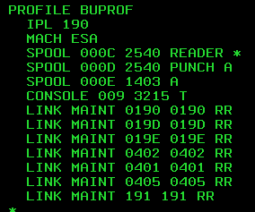

Environment Setup
Create User Pools
  Start your 2nd level machine
  Disconnect from operator and login to MAINT
  Xedit your USER DIRECT file to make a new profile to be used by our workers
  Copy IBMDFLT Profile and change to to look like the following:

Slide 9
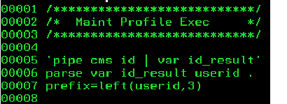
Environment Setup
Use MAINT to 'host' the tools
  Modify MAINT's PROFILE EXEC
    MAINT's PROFILE EXEC will be used by our workers to kickoff their memory and CPU exercisers
    Add logic to check for User ID and kickoff the correct program
    Implement this on your own by editing MAINT's PROFILE EXEC
    The CPU burners have a prefix of 'CPU' and run a REXX EXEC named 'BURNCPU'
    The Memory thrashers have a prefix of 'MEM' and run a REXX EXEC named 'THRASH'

Slide 10
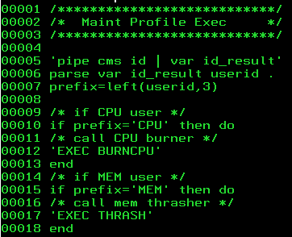
Environment Setup
Modify MAINT's PROFILE EXEC
  Copy BURNCPU and THRASH to MAINT's A-disk
These will be used by the workers to put load on the system

Slide 11
Homework
  Create BOOT EXEC to kick off MEM* and CPU* workers
  The EXEC takes two parameters for user count of each type
    BOOT 1 2 would log on MEM00001 and CPU00001 and CPU00002
  Use XAUTOLOG to log the workers on
  All commands will be run from the MAINT server
  For each worker
    SET SECUSER to MAINT
    SET QUICKDSP ON

Slide 12
Part 2
Homework Review
Perfkit Screens
Lab

Slide 13
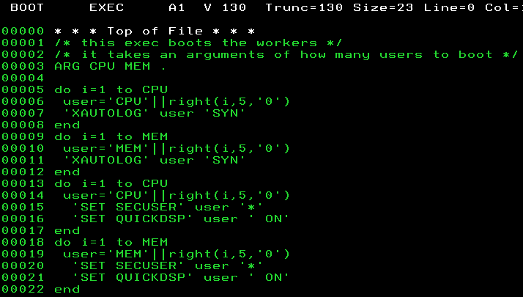
Homework Review
  Create EXEC to kick off workers
  Use XAUTOLOG to log the workers on
  For each worker
    SET SECUSER to MAINT
    SET QUICKDSP ON

Slide 14
5,000 Foot View
History
Files
Raw
Monwrite
MONWRITE Utility
3270
Performance
Toolkit
MONDCSS
Segment
TCP/IP
Network
VMRM
DCSS
SEGOUT
Browser
LINUX
Guest
*MONITOR System Service
VM
IRA
TEMS
VM Events
CP Control
Blocks
Application
Data
OMEGAMON XE

Slide 15
Data collector
Data Generated with
Sample Interval Expires
Event Driven Records
MONDCSS
1. *Monitor writes info to DCSS
2. *Monitor notifies collector
3. Collector processes data
(1)
4. Collector replies to Monitor
(4)
CP
(2)
*MONITOR
05/01/12

Slide 16
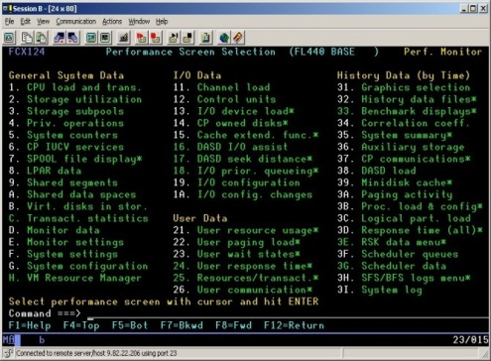
PERFSVM
OPERATOR
MONDCSS
CP
*MONITOR
Your Second Level System

Slide 17
Performance Toolkit Usages
Realtime Monitor
  Allows viewing of current status of the system
  Scheduled report generation
  Recording for historical records
BATCH
  Post processing of Monwrite data
Re-display of historical records
  Capacity Planning
Systems Operations
Central Monitoring of VM systems

Slide 18
Toolkit Overview
PERFSVM server
Explain Realtime (Demo)
Ways to get to screens
  Main Menu (type MENU)
  Menu Numbers (e.g. 1)
  Or display names (e.g. CPU)
AVERAGE vs. CURRENT
HELP cursor on field name hit PF1

Slide 19
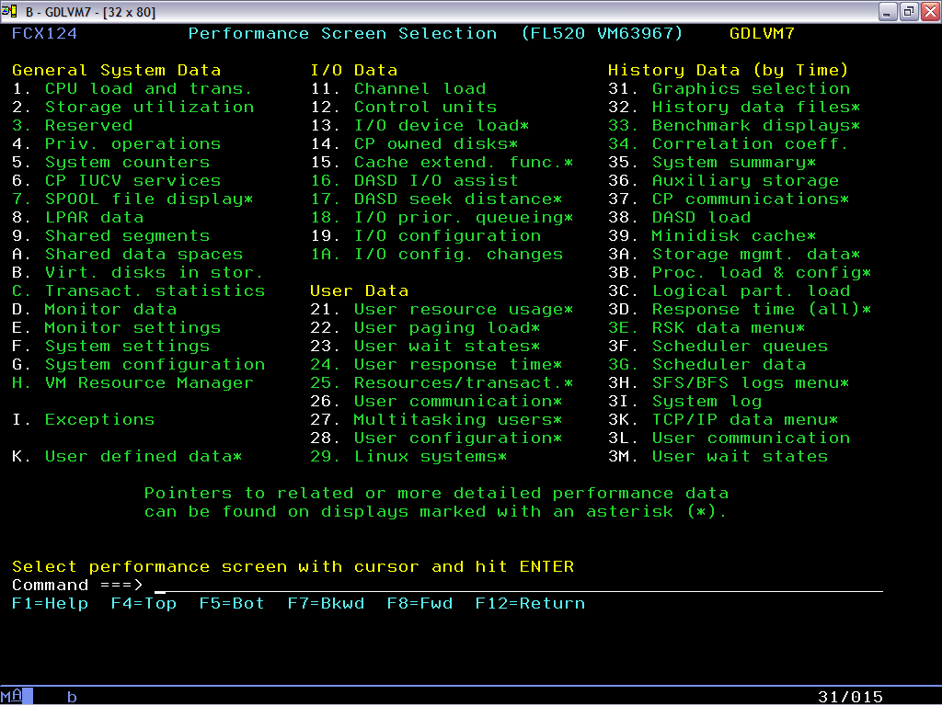
PERFSVM – Performance Toolkit
Logon to PERFSVM on second level system
PROFILE EXEC will execute:
  Configure some monitor settings
  Start Performance Toolkit via PERFKIT MODULE
Should see main menu:
  To return to this screen, go to “Command ===>” and type:
    menu

Slide 21
Screen Identifier FCX###

Slide 22
Screen Menu Number
White: Report is available

Slide 23
Put cursor on number and hit ENTER to select
Type Menu Choice here (eg. 21)
Or screen display name (eg USER)

Slide 24
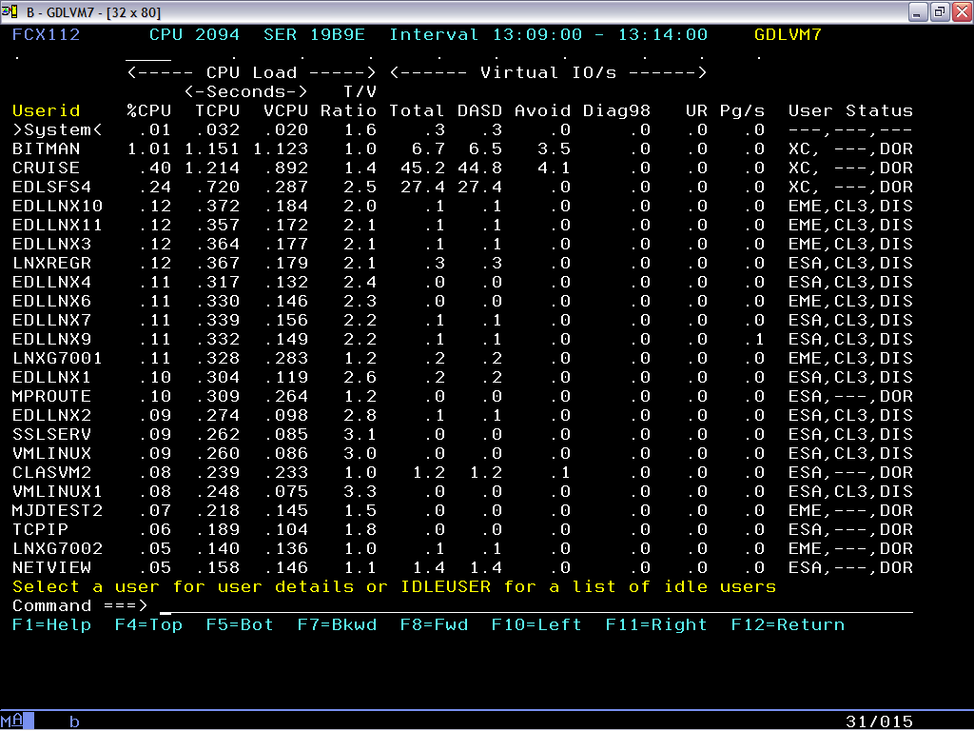
Dots = Sort Choices
Sort indicator
Click user and drill down
05/01/12

Slide 25
Span of time reported is shown in interval. Usually maps to the current monitor interval, 5 minutes in our example here
Typing “Current” or “Average in command line, will toggle between the current interval and the average since Toolkit as started.
05/01/12

Slide 26
Navigating and Hints
To return to main menu at any time, go to “Command ===>” and type:
    menu
FCX### in top left corner identifies screen
You can navigate to a screen via
  Putting cursor on menu number and pressing ENTER
  Typing menu number after “Command ===>”
  Typing Screen Display name after “Command ===>”, such as USER or USTAT
Certain reports allow sorting by putting cursor on “dot” above a column and pressing ENTER. An underscore mark indicates the column currently being used for sorting.
Enter Average or Current in “Command ===>” to toggle between average since toolkit was started and current interval.

Slide 27
CPU Related Screens
FCX100 CPU (Menu 1)
  %CPU
  %CP
  %EMU
FCX112 USER (Menu 21)
  %CPU
  Sorting
FCX115 USER userid Detail

Slide 28
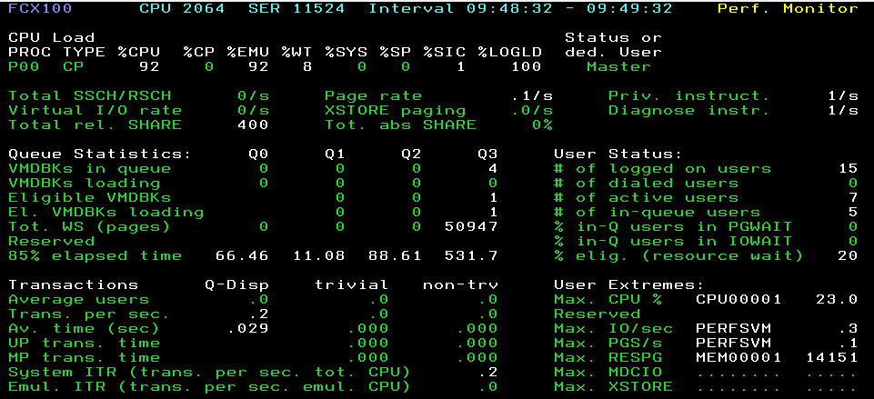
CPU

Slide 29
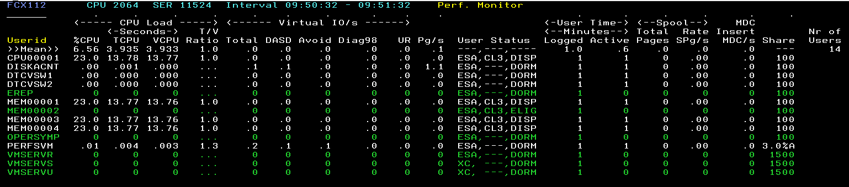
User

Slide 30
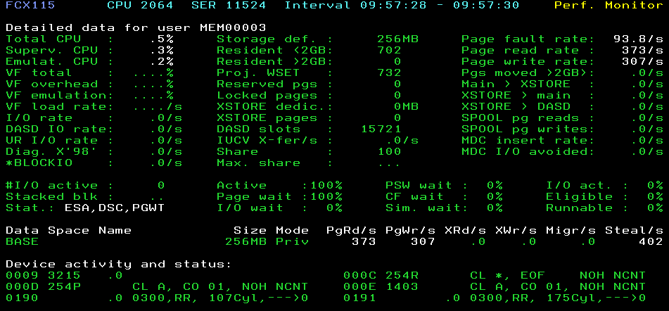
User Detail

Slide 31
Memory Related Screens
System
  FCX109 DEVICE CPOWN (Menu 14)
  FCX103 STORAGE (Menu 2)
Virtual Machine
  FCX113 UPAGE (Menu 22)

Slide 32
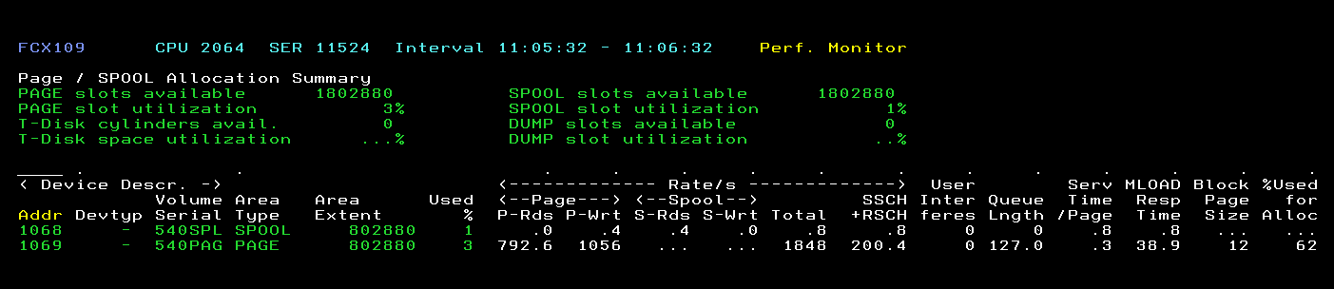
Device CPOWN

Slide 33
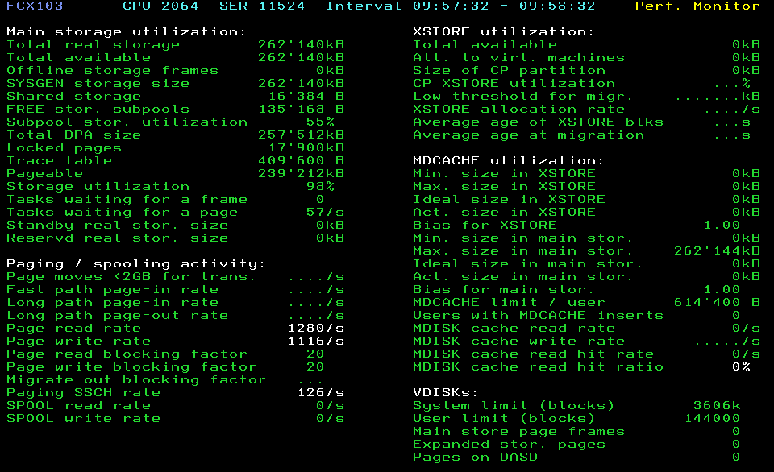
Storage

Slide 34
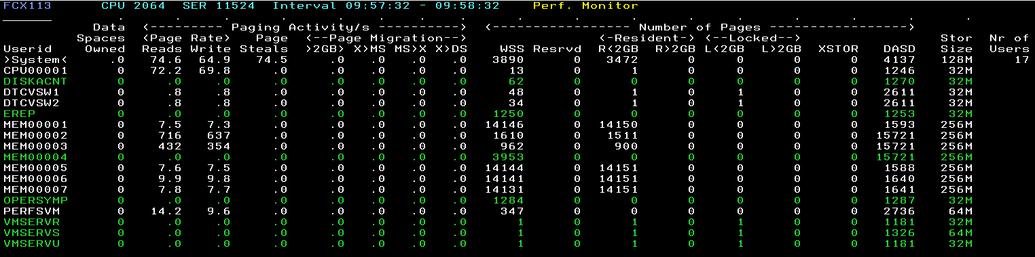
UPAGE

Slide 35
Other Useful Screens
System
  FCX153 Exceptions (Menu I)
  FCX105 Graphics selection (Menu 31)
  FCX225 System summary (Menu 35)
Virtual Machine
  FCX114 USTAT (Menu 23)

Slide 36
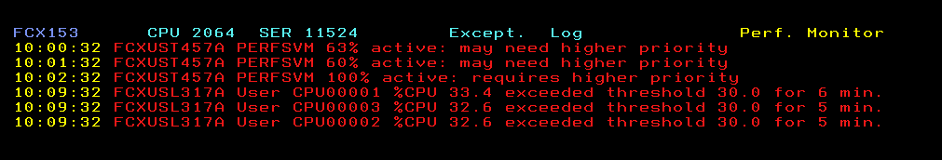
Exceptions

Slide 37
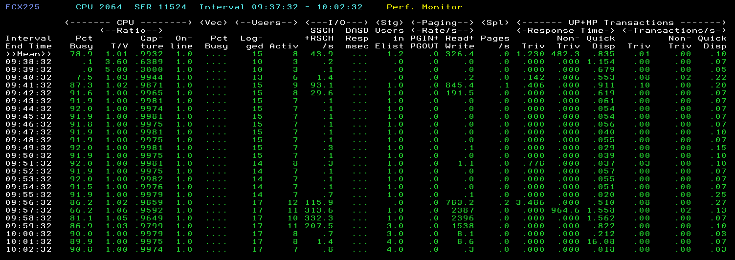
System Summary

Slide 38
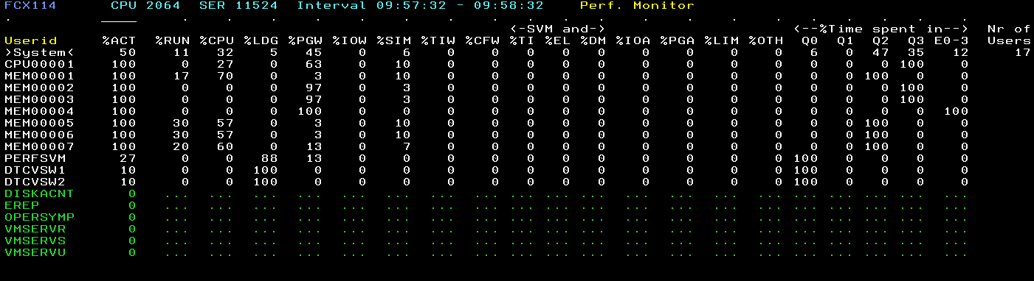
USTAT

Slide 39
Environment Setup
To setup our environment we will:
  Create CPU Burning and Memory Thrashing worker machines
  Give the workers read only access to MAINT's A-disk
  Add logic to MAINT's PROFILE EXEC to allow the workers to use it to start their programs
  Put CPU Burning and Memory Thrashing execs on MAINT's A-disk
  Write a tool to kick off workers for our experiments next class

Slide 40
Environment Setup
  Logon PERFSVM
  CP set prod 5vmpkt40 (or 5vmptk40) state enabled
  Att 191 * 291
  Acc 291 fm
    Hit Enter
    Enter MON to start Monitoring and bring up the Menu screen
  From MAINT issue 'XAUTOLOG CPU00001'
  From PERFSVM enter 'USER'
    Verify that the user CPU00001 is up running and using CPU

Slide 41
Setup DIAL
DIAL will allow you to have 2 terminals in your 2nd level system so we can simultaneously log on to MAINT and PERFSVM
To enable 'DIAL' :
  On your 1st level user 'DEF GRAF 60'
    This adds a display station to your virtual machine
  IPL your 2nd level system
    On Maint 2nd level SET rdev 60 type 3270
    On MAINT 2nd level 'VARY ON 60'
    On MAINT 2nd level 'ENABLE 60‘
    Q graf free which does what?
    Open another 3270 terminal on the 'COMMAND' line enter 'DIAL' your user ID
    You now have the ability to have two 3270 Terminals into your 2nd level system at the same time.
      Logon to PERFSVM
      CP SET prod 5vmptk40 state enabled
      IPL 190
      ISSUE ‘MON’ to start Monitor and then ‘USER’ to go to the user screens

Slide 42
THRASH Overview
Uses a stem variable to fill memory
Does not require VM to do much work on its behalf, on an unconstrained system T:V ratio should be near 1.0
% virtual CPU can be used to estimate transaction rate

Slide 43
Paging Observations
Look at Page %CPU, counts and rates (UPAGE,CPOWNED, USTAT)
Q1: What users pages are on DASD? Why?
XAUTOLOG 3 MEM Workers
Q2: What users pages are on DASD? Why?
XAUTOLOG 2 more MEM Worker for a total of 5 MEM workers
Wait an interval to let the system settle
Q3: What happened to %CPU, USTAT, Paging rates and T/V Ratio for the users?
Q4: What is the memory over commit ratio, (virtual memory to real) for the system? (256 pages in 1M, your systems are 256M)
Q5: On average how much of the workers virtual memory is resident?
Q6: What scheduler class(es) are the workers in?

Slide 44
Memory Set QUICKDSP OFF
Look at Page %CPU, counts and rates (UPAGE,CPOWNED)
From MAINT: SET QUICKDSP MEM00002 OFF
Q1: What Scheduler class is MEM00002 in?
Q2: Have MEM00002's paging characteristics changed?
Q3: Is MEM00002 being treated the same as the other MEM workers?
Force all workers off
Final Question:
  In measuring performance, external factors can change results , list 3 external factors that could influence your environment?

Slide 45
The End
04/06/14

